Slide 1
Data-Driven Insights: Machine Learning Approaches to Traffic Speed Analysis
Kevin Loi
Jiang Guo
California State University, Los Angeles

Slide 2
Background
Objective: To model and analyze traffic speed data using ML techniques for predictive insights and data-driven decision-making.
Machine Learning Algorithms Used: Polynomial Regression, Clustering, Decision Tree

Slide 3
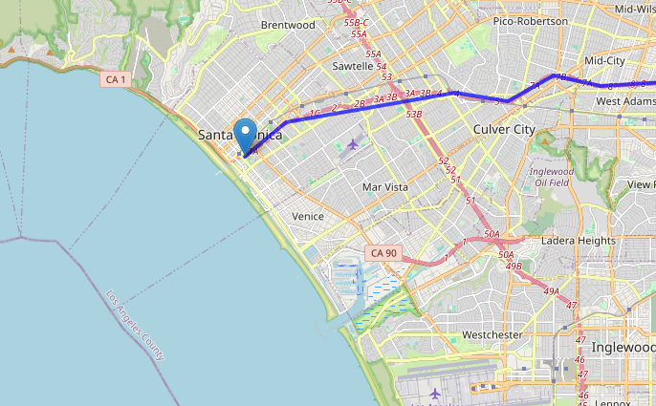
Data Location
We are working with data collected in the Santa Monica area

Slide 4
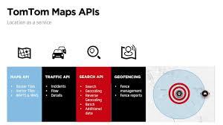
Data Source
Data comes from the TomTom API
TomTom API provides real time traffic data including current speed, travel time, time, location on a map, and any street closures

Slide 5
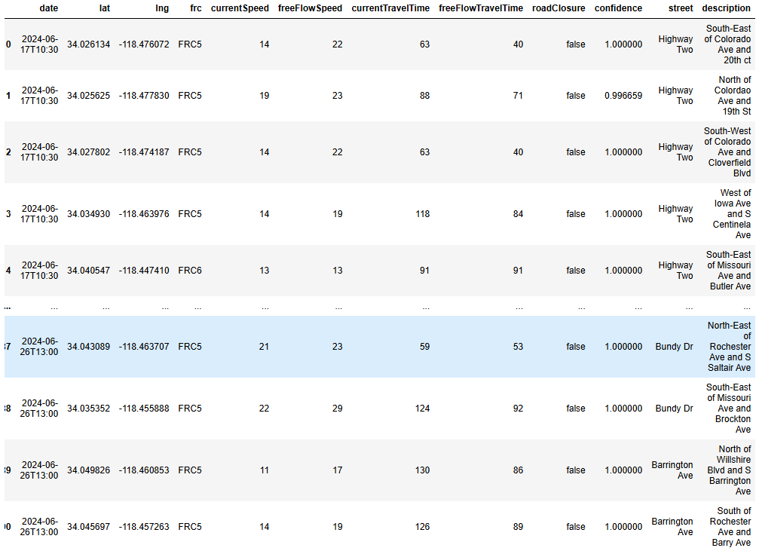
Re-organized Data

Slide 6
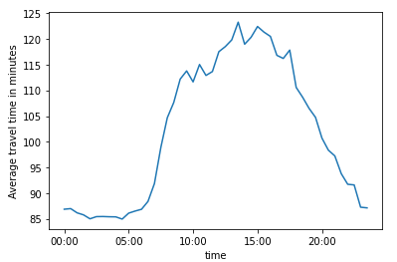
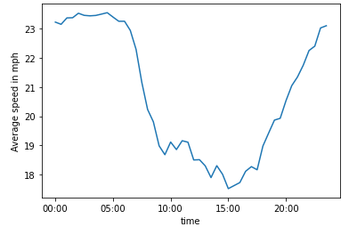
Day Time vs Average Speed
Around 6-7 am is when average travel time increases and average speed on the road decreases
Traffic is the worst at 10 am to 8 pm with 3 pm being the worst traffic
After the 3 pm traffic, the average speed and travel time doesn’t return to 6-7 am speeds until towards midnight

Slide 7
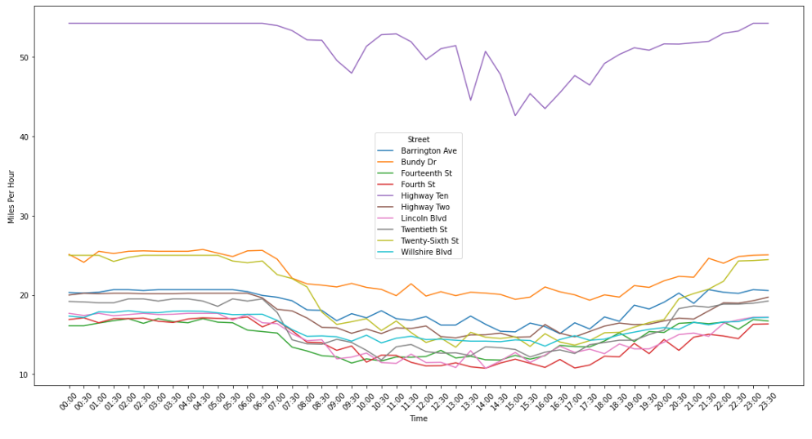
Traffic Slowdowns During Peak Hours
All of the streets in the data experiences a drop in speed during peak times of the day (9:00 to 17:00)

Slide 8
Speed Prediction
Linear/Polynomial Regression
features = ['freeFlowSpeed', 'currentTravelTime', 'freeFlowTravelTime','hour','lat','lng']
X = traffic_df[features]
y = traffic_df['currentSpeed']

Slide 9
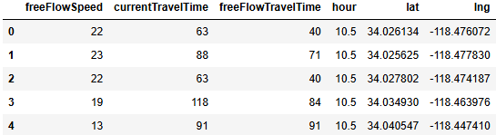
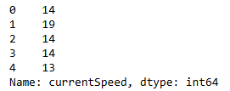
X
Y

Slide 10
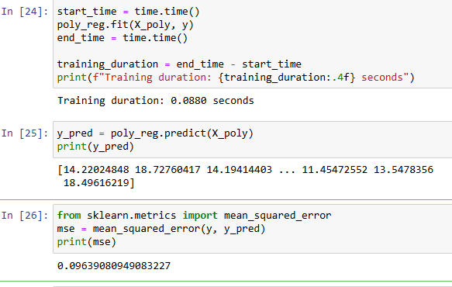
Polynomial Regression
Test size: 0.33, random state = 0.3
Time function used to record training duration for optimal model selection
Training time vs. Accuracy
Mean squared error = 0.0963 at degree 4
Goal is to minimize MSE, while preventing the problem of overfitting

Slide 11
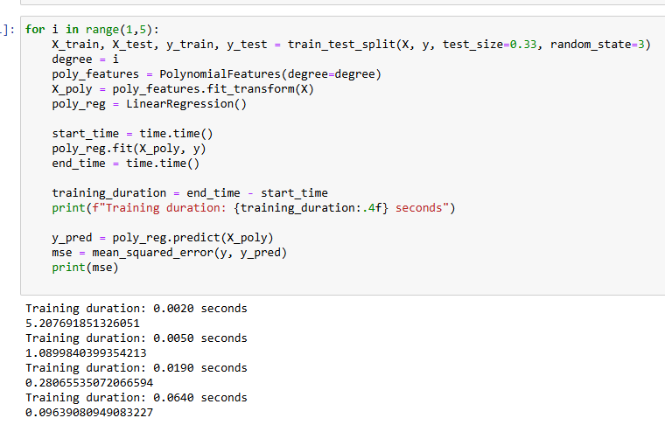
Polynomial Regression cont.
Using the same test_size and random_state
Train the model using a regression of degree i
(i = 0, 1, 2,3, …)
As we increase the degrees of polynomial, the training team increases, but the mean squared area decreases
Want to keep a good size degree to prevent overfitting

Slide 12
Classification
KNN
Create a range and label the speed of the traffic using KNN
Decision Tree

Slide 13
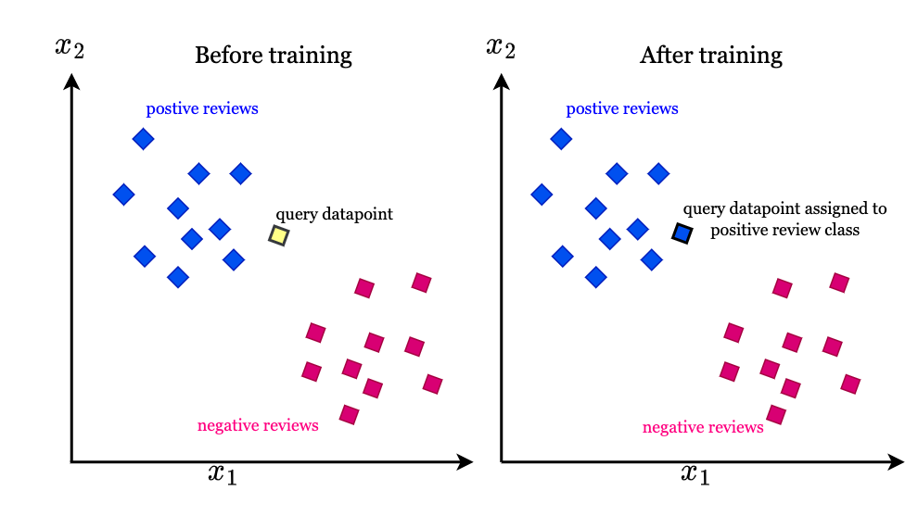
KNN (K-Nearest-Neighbors)
A classification model where an unclassified point leverages classified points in its surroundings to predict the label of the unclassified point
Nearest neighbors = number of points to help classify a point
For example: We have an unclassified point and 2 classes (Class A and B) with k = 5
To label the point, we take the 5 nearest points to the unlabeled point
The majority of points in k nearest neighbors to the point, will label the unlabeled point as that label

Slide 14
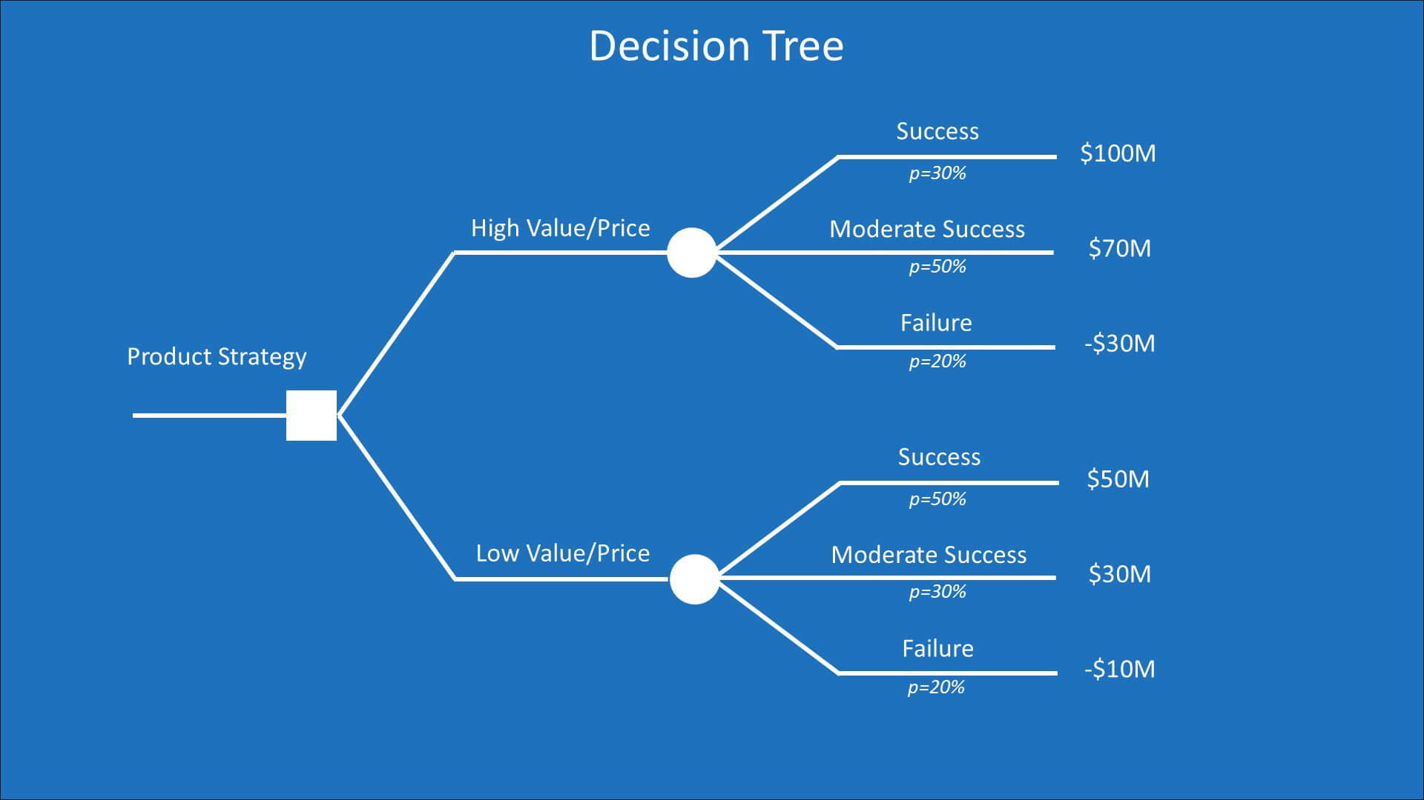
Decision Tree
A classification model that splits data into groups based on their qualities
Uses qualitative data and predefined grouped quantitative data
For example
Qualitative - Cities in LA County
Quantitative - Traffic Slowdown Rate

Slide 15
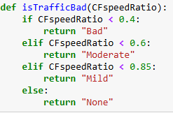
Traffic Types
4 different types of traffic have been predefined: No Traffic, Mild Traffic, Moderate Traffic, Bad Traffic
CFspeedRatio used as it indicates (Current Flow Speed / Free Flow Speed)
Bad Traffic is any traffic speed that is less than 0.4
Moderate is between 0.4 and 0.6
Mild traffic is between 0.6 and 0.85
No Traffic is above 0.85

Slide 16
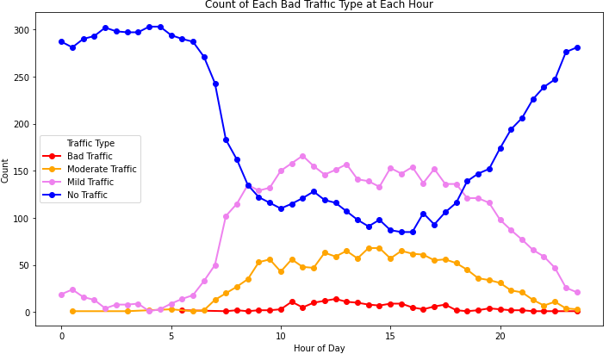
Count of Each Traffic Type at Each Hour

Slide 17
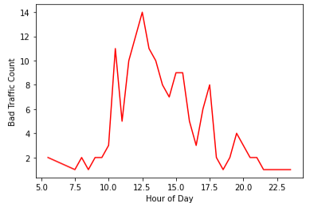
Count of Bad Traffic at Each Hour

Slide 18
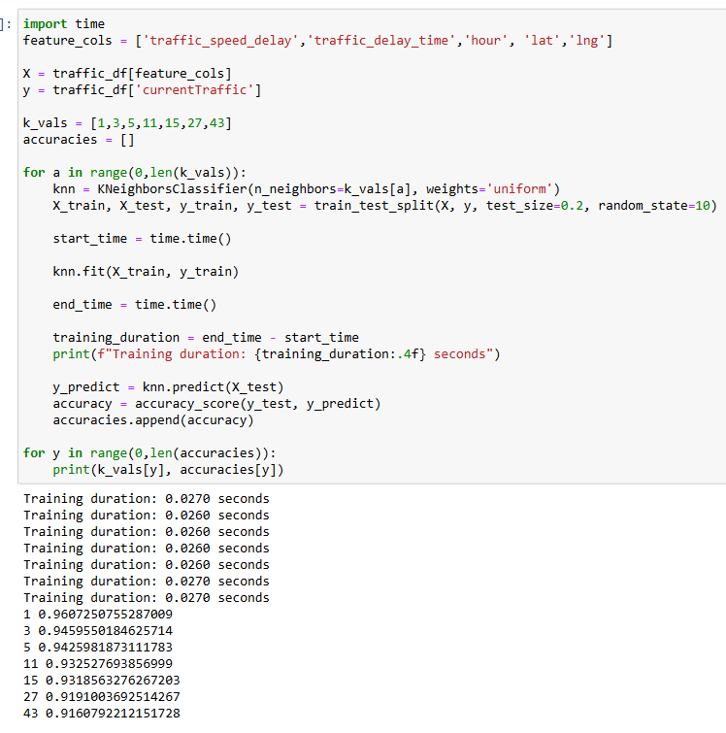
KNN Classification
Test_size = 0.2 and random_state = 10
0.027 seconds average runtime
A smaller k results in higher accuracy
Time function to record how long it takes to train the model
Defined k as (1,3,5,11,15,27,43)
K = 1,3 yields the best results, but all k results in roughly the same training duration

Slide 19
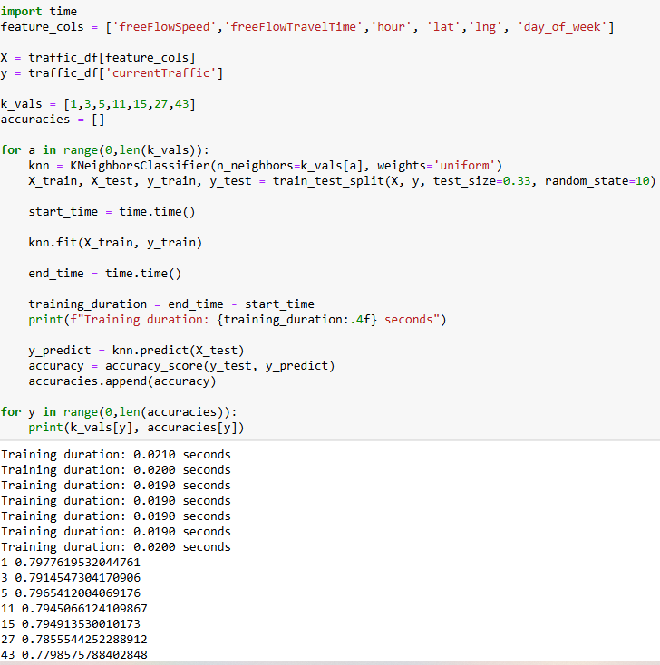
KNN Classification cont.
Without using current speeds/travel time we have a more informative predictive model
Replaced Traffic delay with freeFlowSpeed and Travel Time
Training time is around 0.21
A k of 1-5 gives the highest accuracy at 79.7%

Slide 20
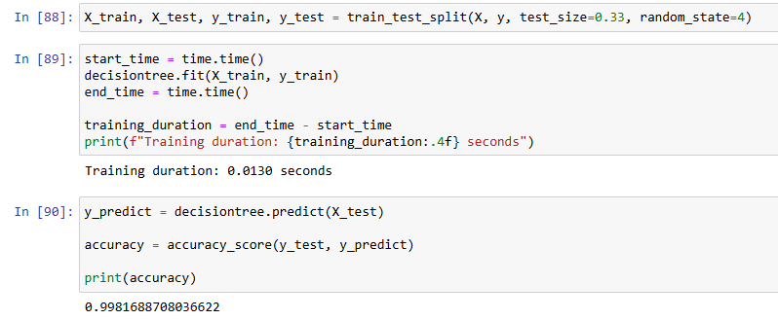
Decision Tree
Test_size = 0.33 random state = 4
Decision tree yields a higher accuracy than KNN
Has a slightly faster run time than KNN
Great at labeling the 4 traffic types

Slide 21
Future Work
Traffic Simulation
Adding more features
Amount of Lanes
Number of intersections
Frequency of accidents
Weather
More Streets
Utilize LSTM

